Slide 1
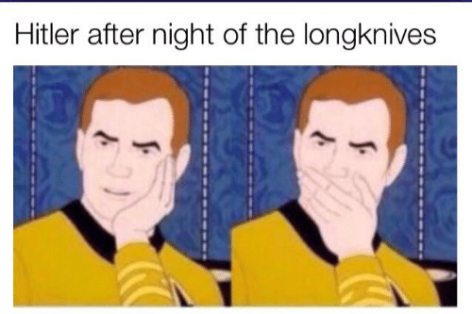
History Heroes
Week 5

Slide 2
1. What date did Hitler become Chancellor? (3 marks – day, month, year)

Slide 3
2. What date was the Reichstag Fire? (3 marks – day, month, year)

Slide 4
3. Who was blamed for starting the Reichstag Fire? (1 mark)

Slide 5
4. What decree was put into place as a result of the Reichstag Fire and what was its importance? (2 marks)

Slide 6
5. What date was the Night of the Long Knives? (3 marks – day, month, year)

Slide 7
ANSWERS

Slide 8
1. What date did Hitler become Chancellor? (3 marks – day, month, year)
30 January 1933

Slide 9
2. What date was the Reichstag Fire? (3 marks – day, month, year)
27th February 1934

Slide 10
3. Who was blamed for starting the Reichstag Fire? (1 mark)
Communist Martinus van der Lubbe

Slide 11
4. What Act was passed as a result of the Reichstag Fire and what was its importance? (2 marks)
Emergency Decree
Banned the Communists from the elections.

Slide 12
5. What date was the Night of the Long Knives? (3 marks – day, month, year)
29th June 1934

Slide 13
RESULTS /12

Slide 14
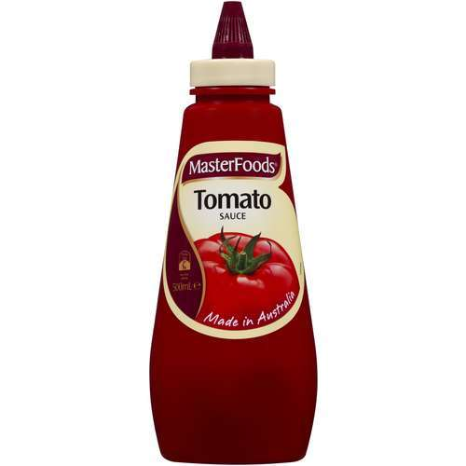
Source of the week

Slide 15
“The smoothness with which the murders of 30 June were carried out is powerful proof that no Rohm plot was imminent. There was no resistance encountered anywhere…many victims unsuspectingly surrendered voluntarily, believing it was all a big mistake. The only shots fired were those of the executioners…the numbers of victims is estimated at between 150 and 200.”
-The historian Karl Bracher, in his book ‘The German Dictatorship’, 1971

Slide 16
Hitler’s consolidation of power
The Reichstag fire and the Enabling Act
Night of the long Knives
Process of ‘Gleischaltung’
The path to Dictatorship

Slide 17
What do we know so far…

Slide 18
Reichstag fire

